Slide 1
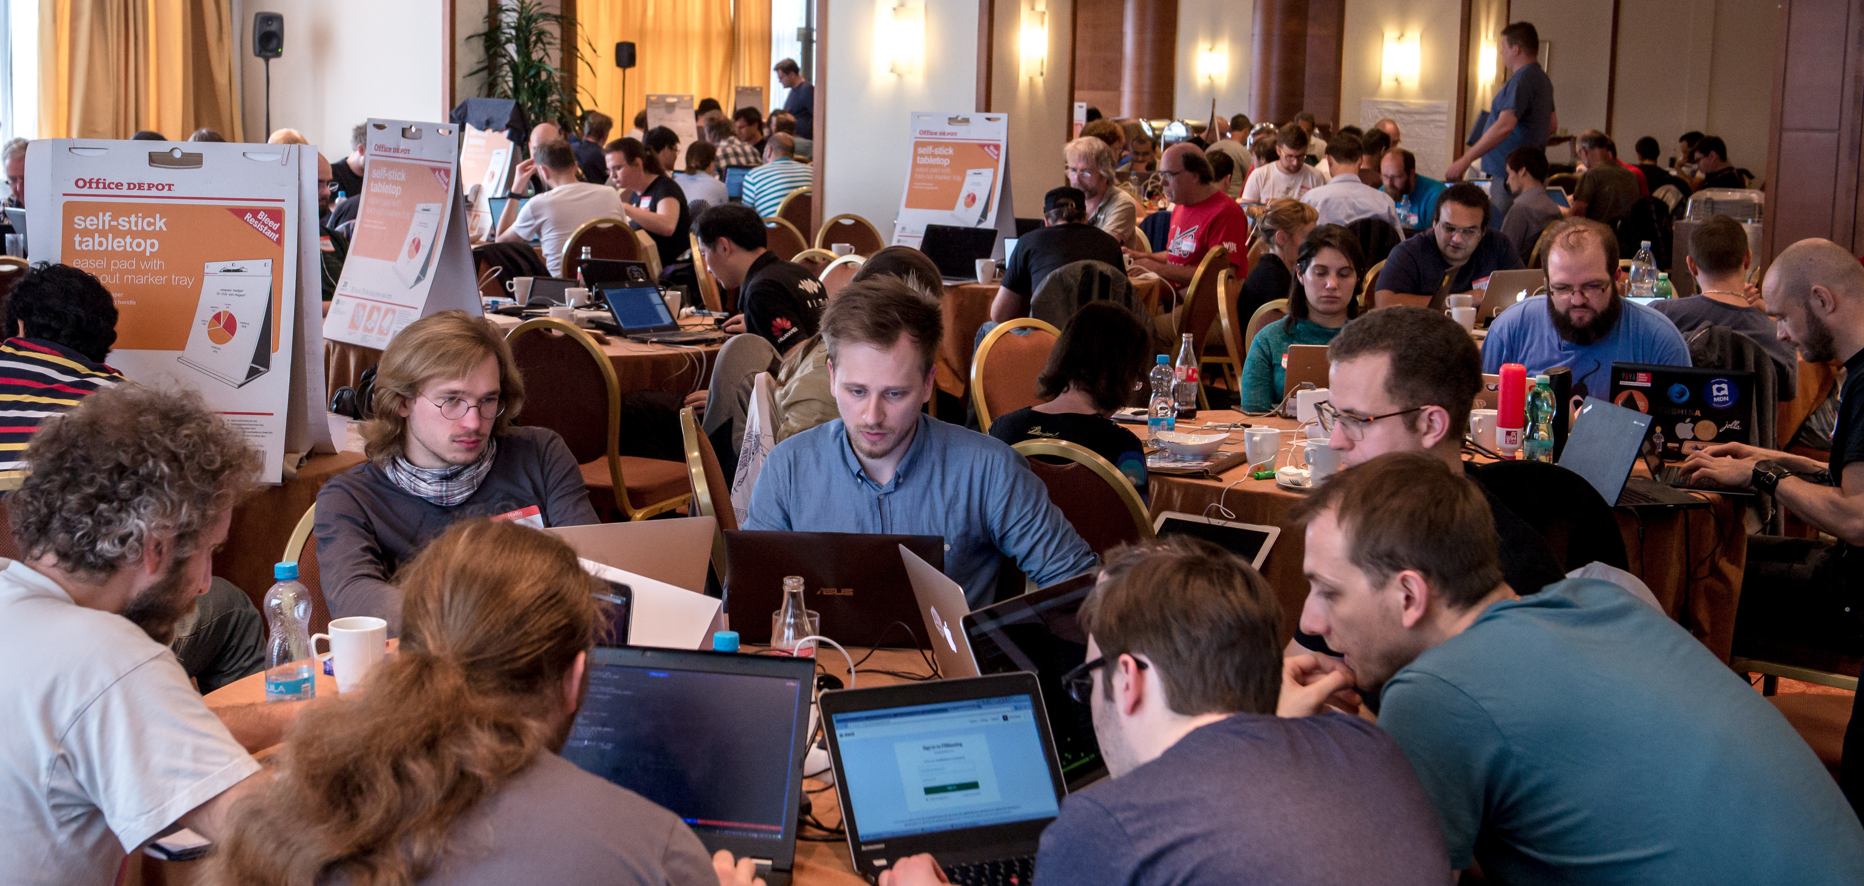
IETF 99 Hackathon

Slide 2
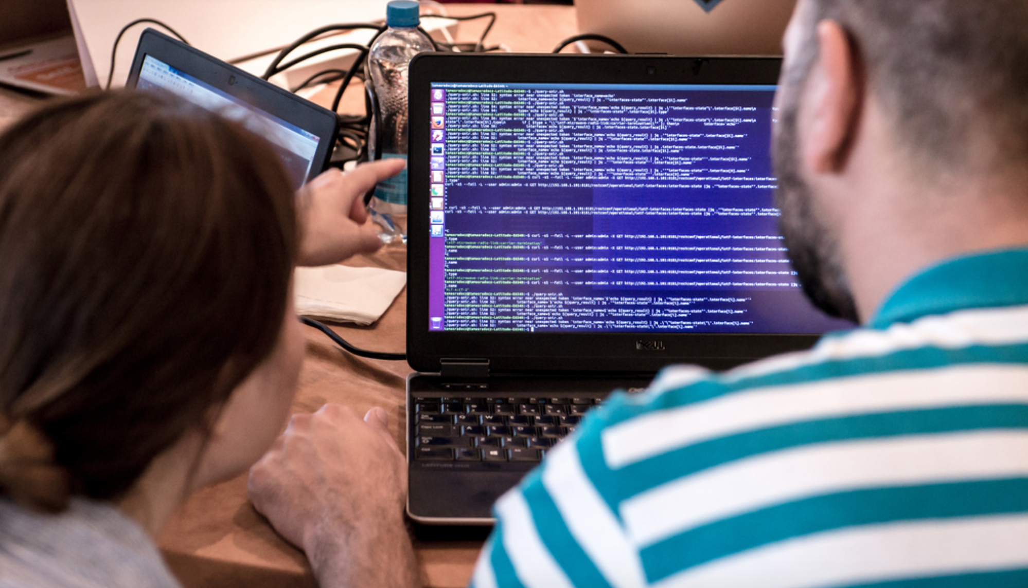
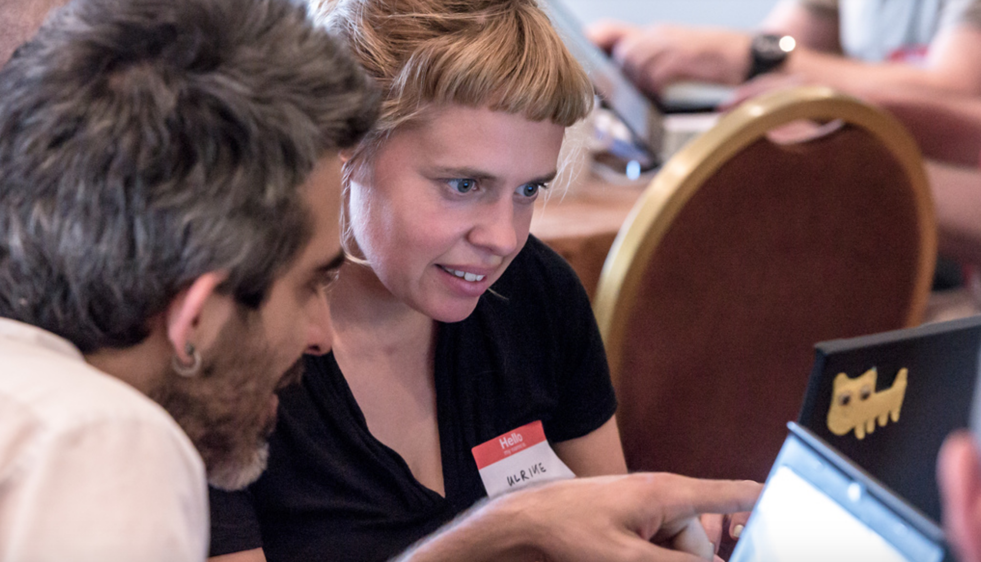
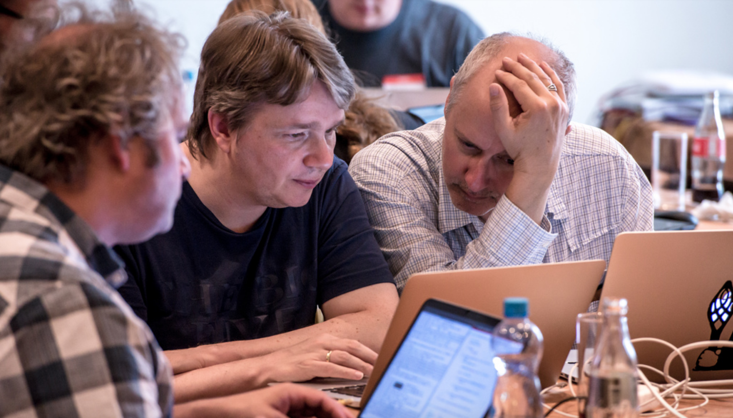
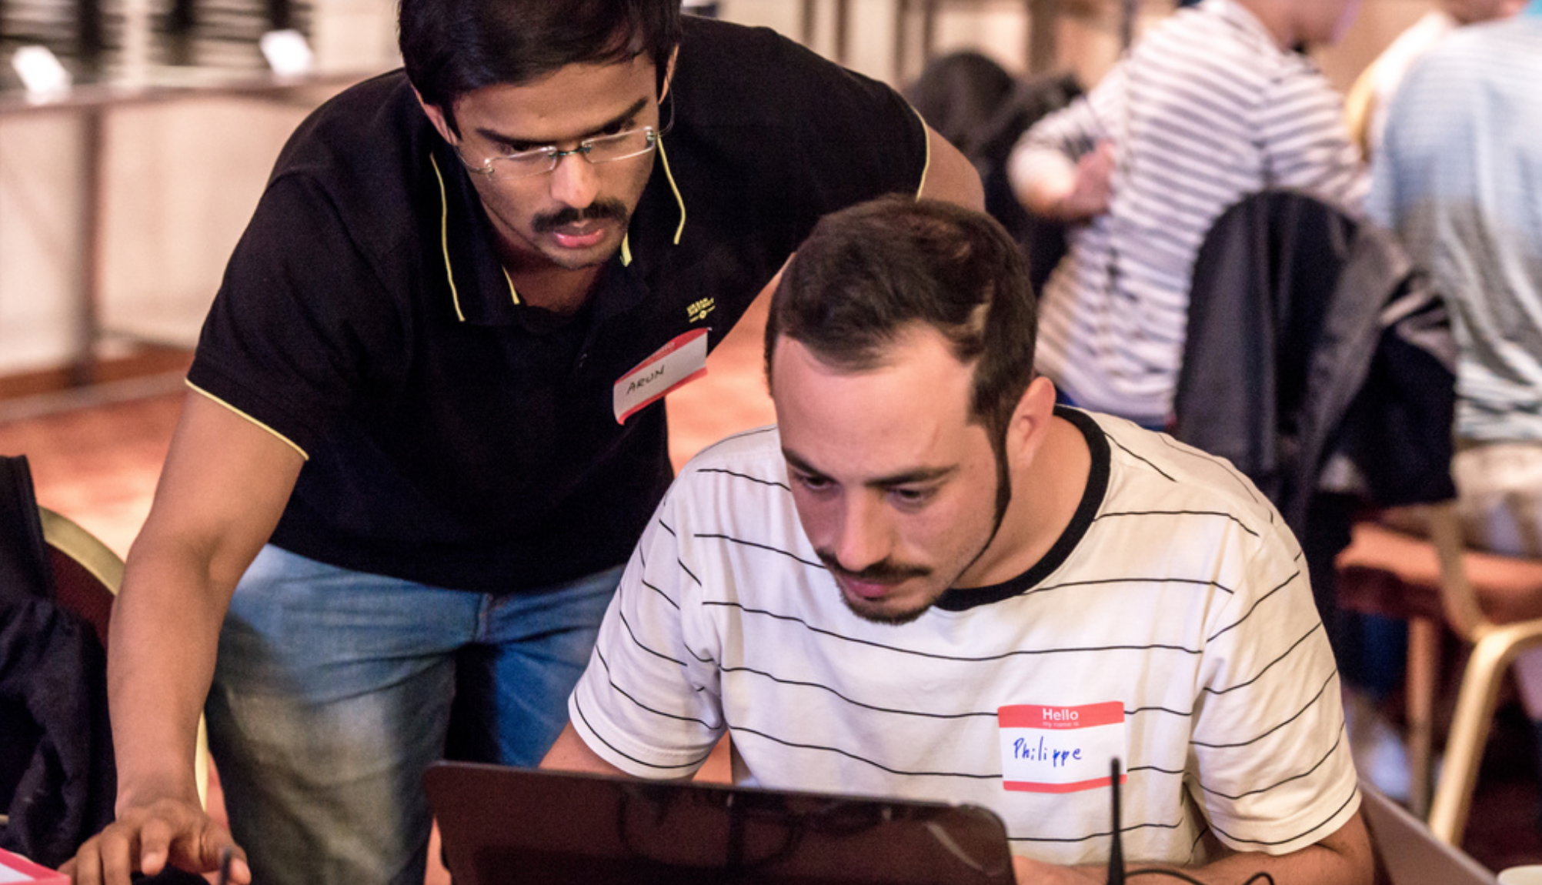
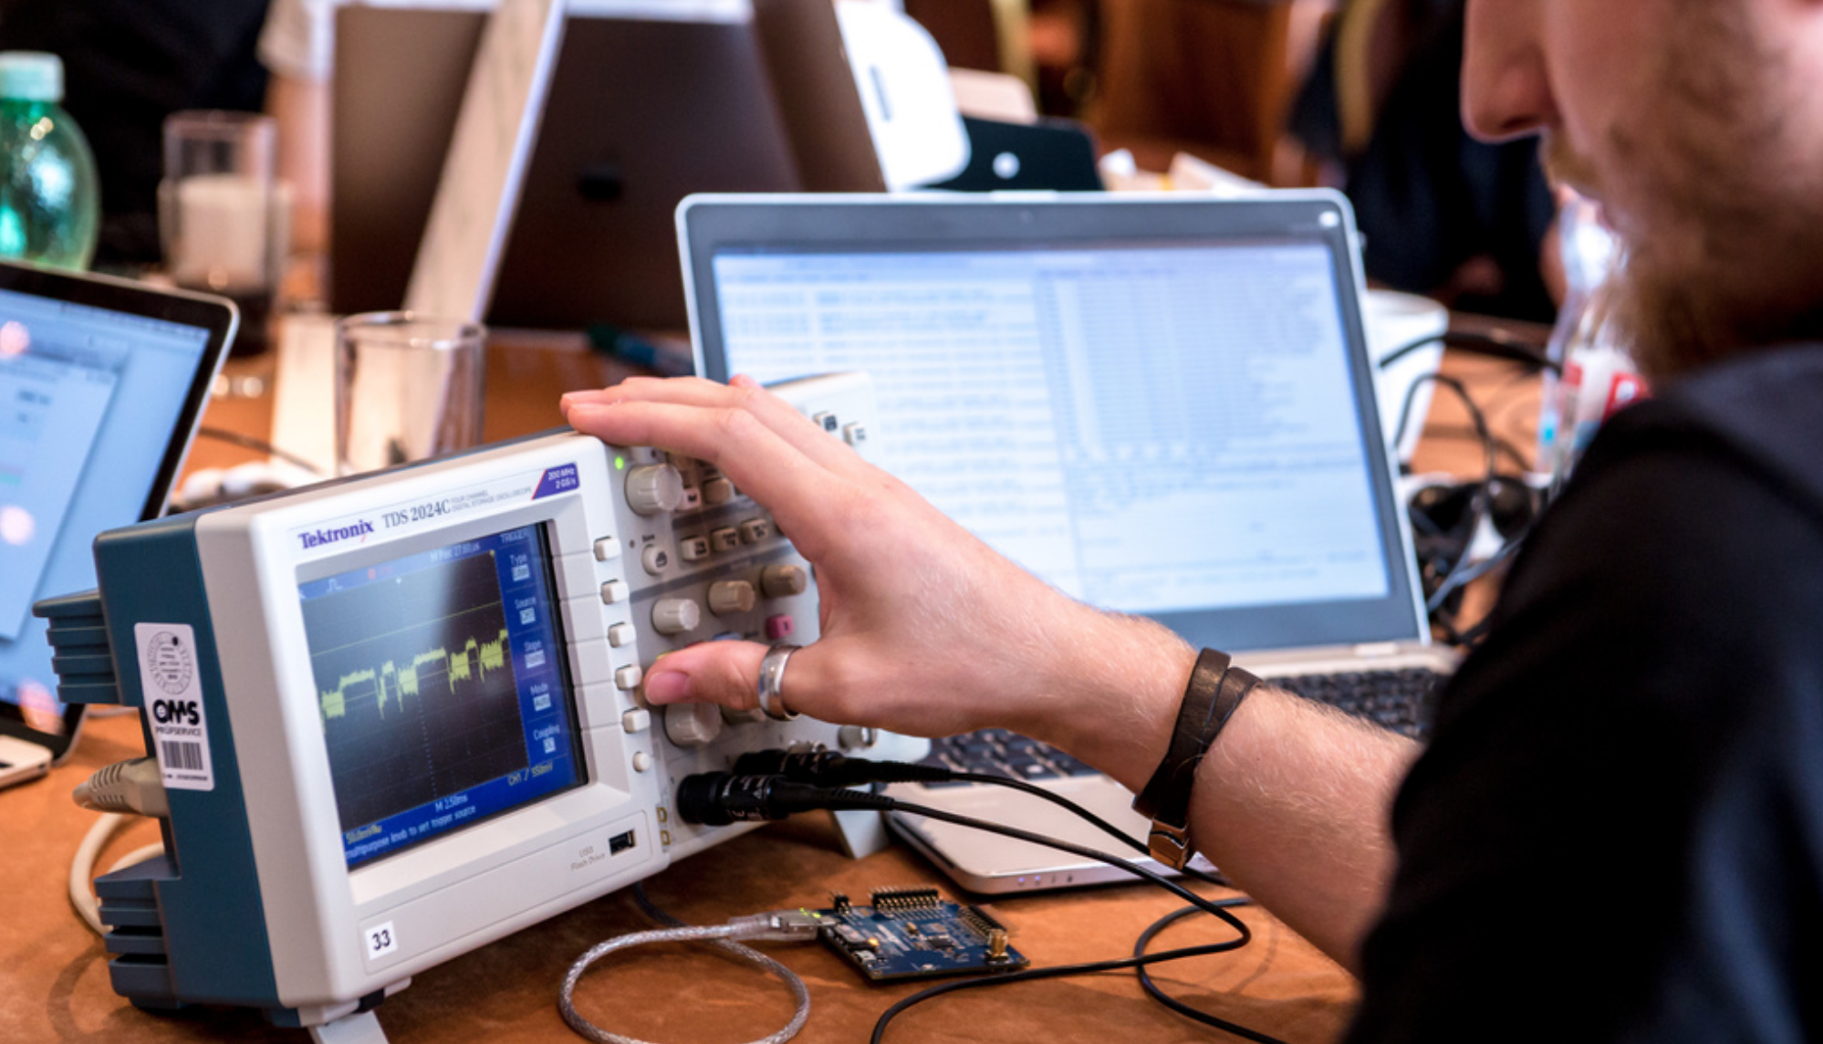
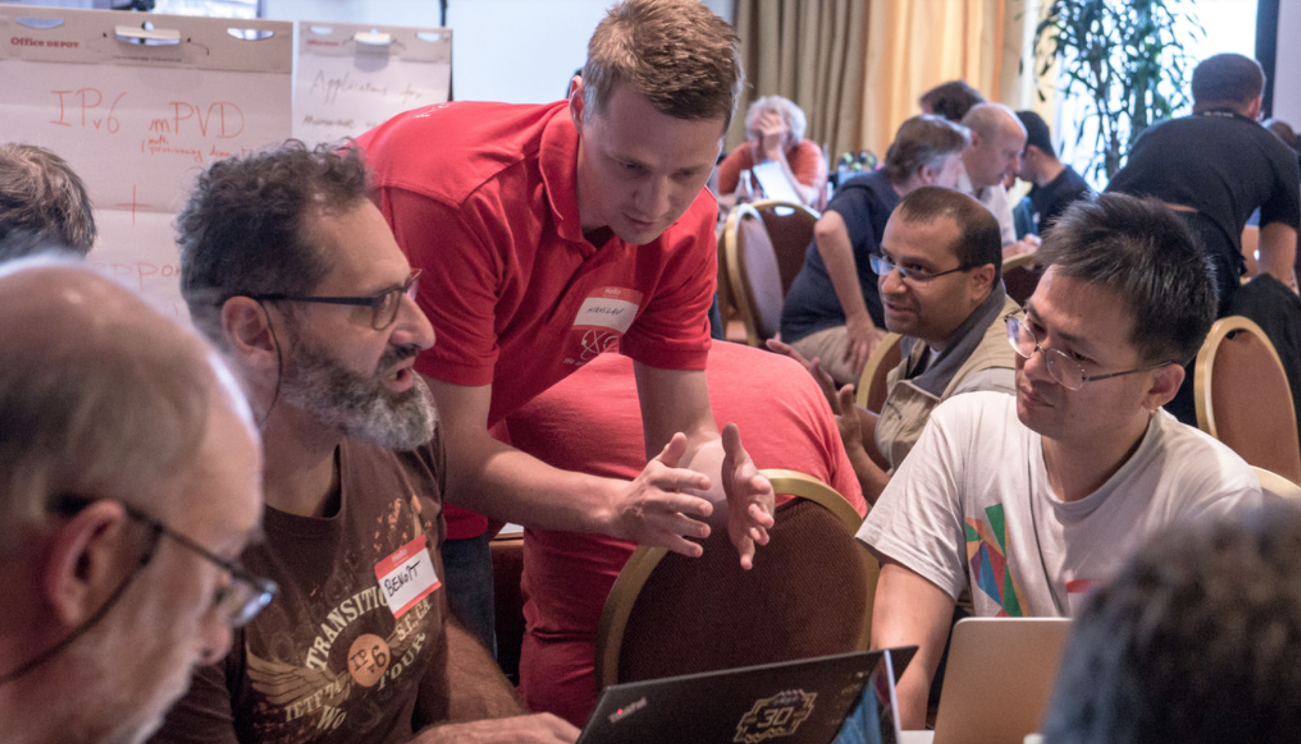
Goals
Collaborate and Learn
Running Code (RFC 6982)
Speed/Relevance of Standards
Feedback to Working Groups
Grow IETF Community

Slide 3
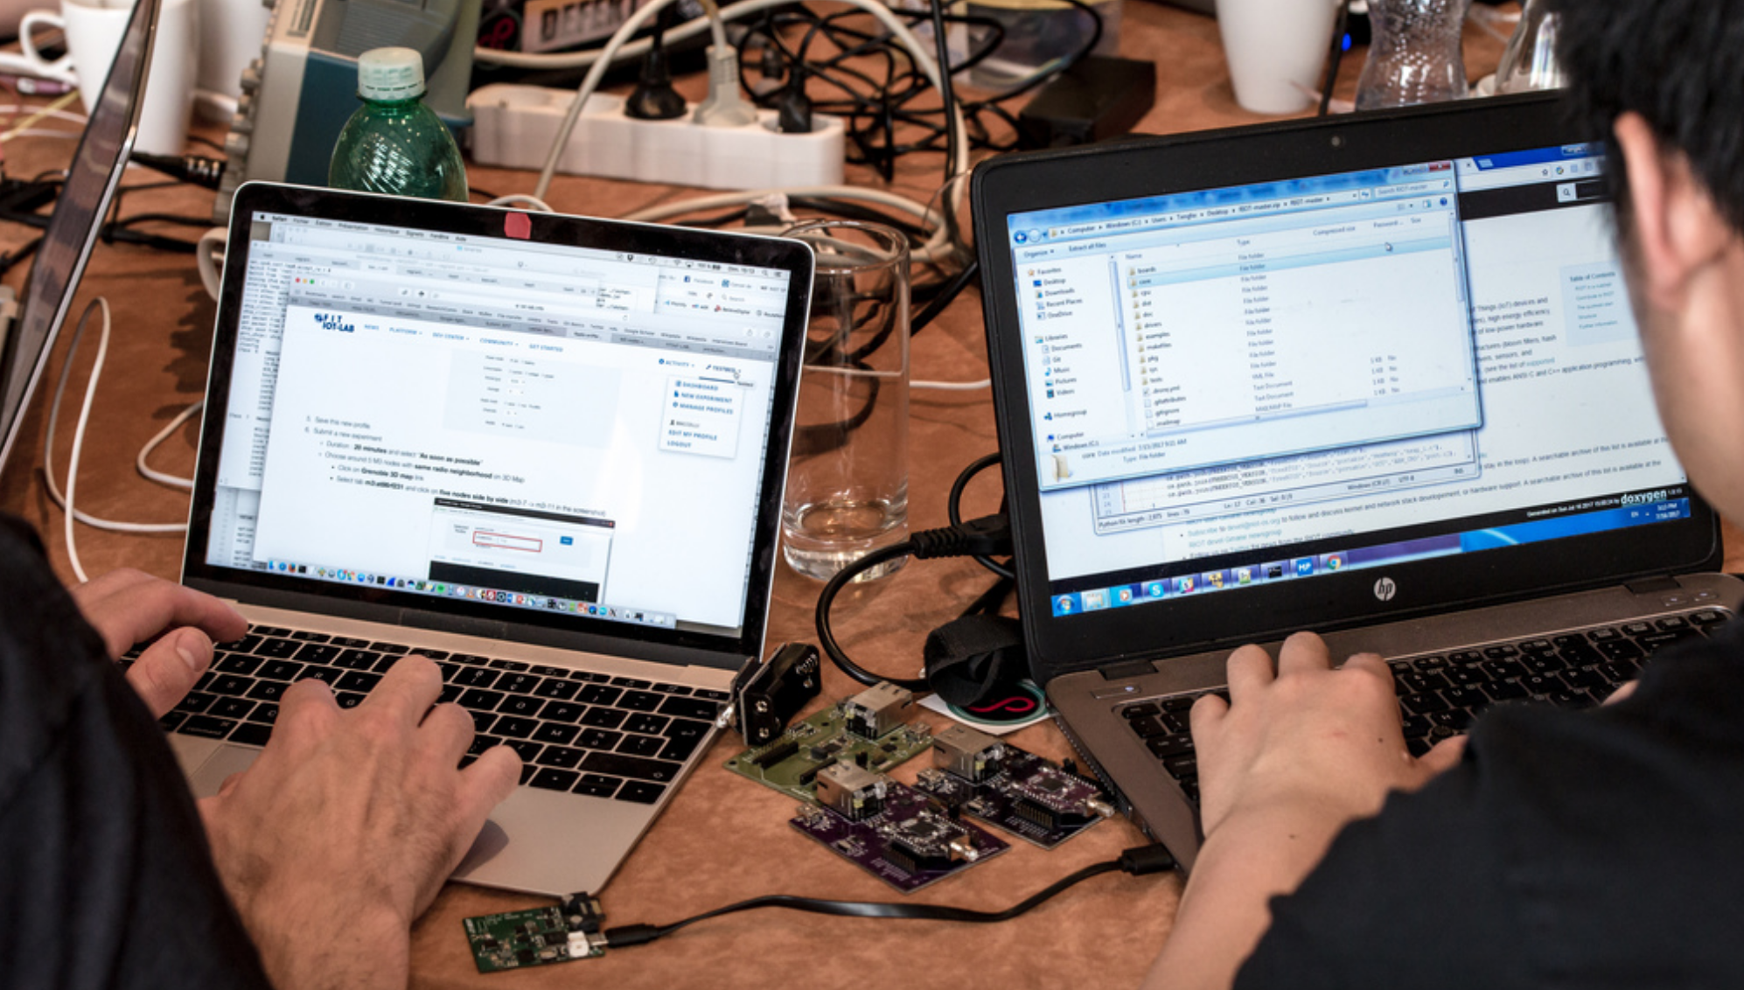
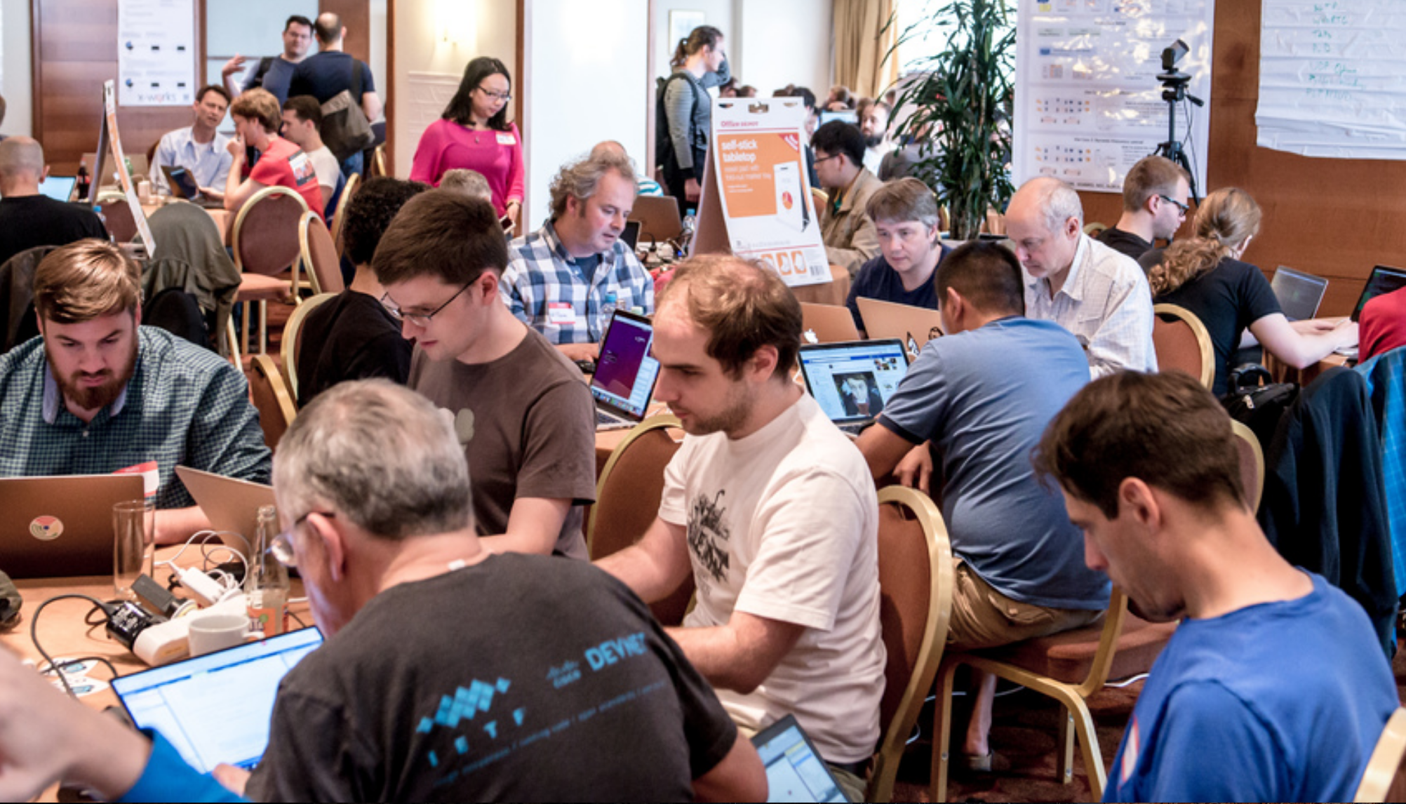
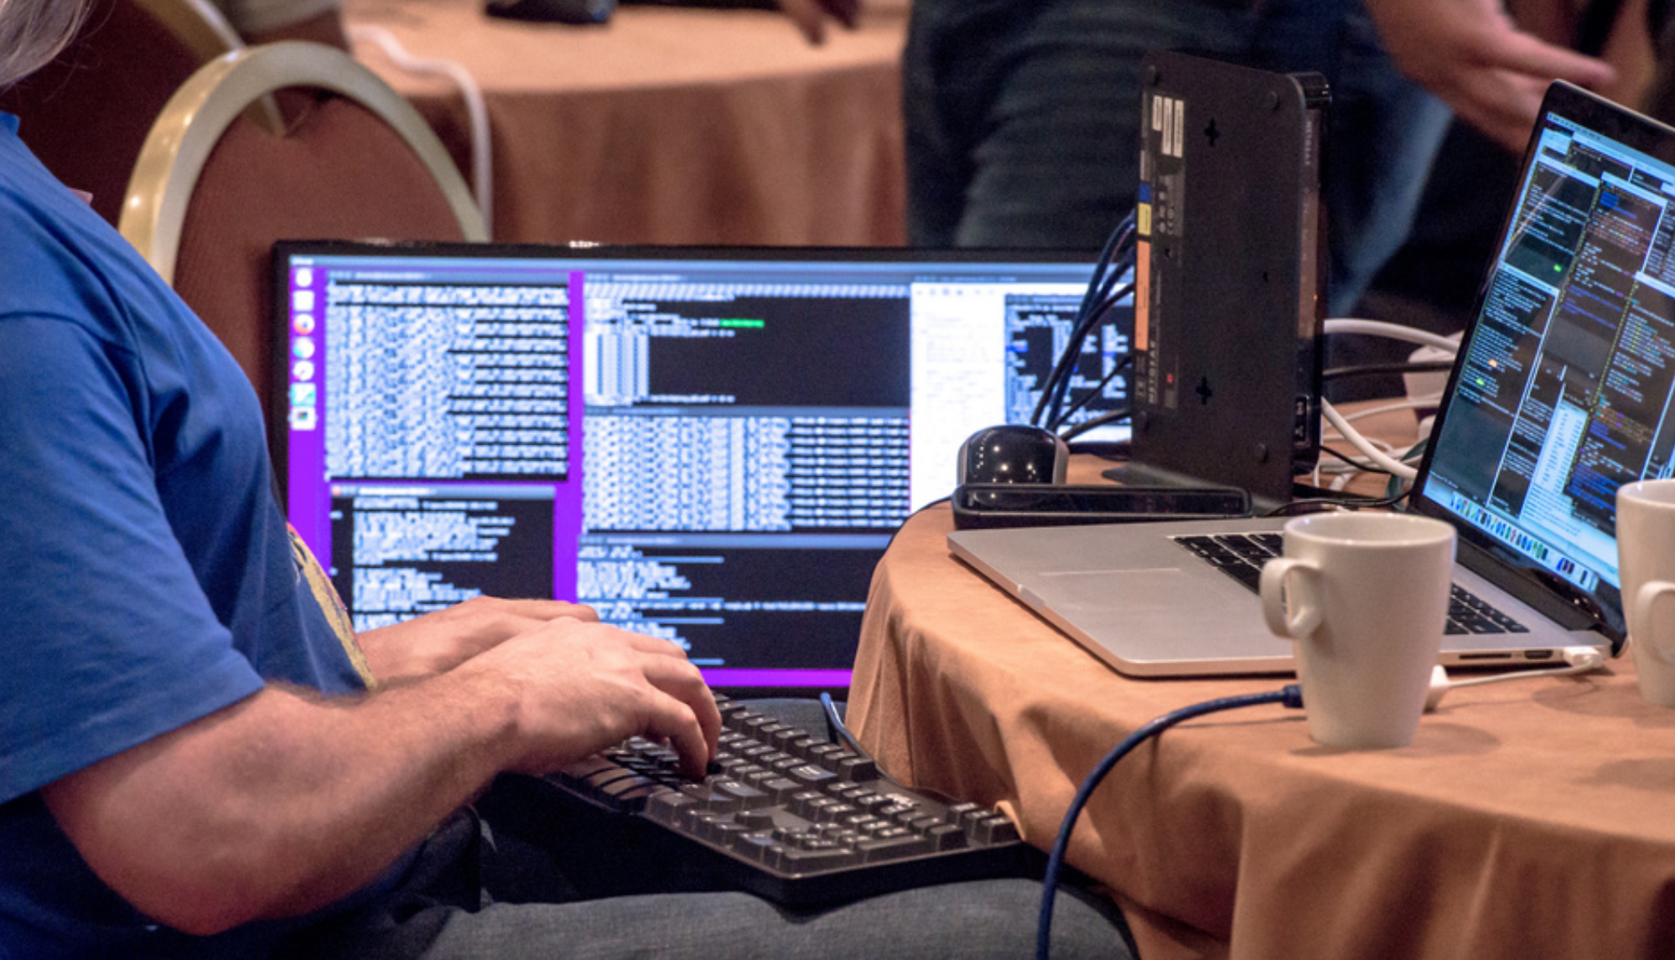
Stats
8th Hackathon
199 registered participants *
45 first IETF *
89 first IETF hackathon *
25+ projects *
New Records

Slide 4
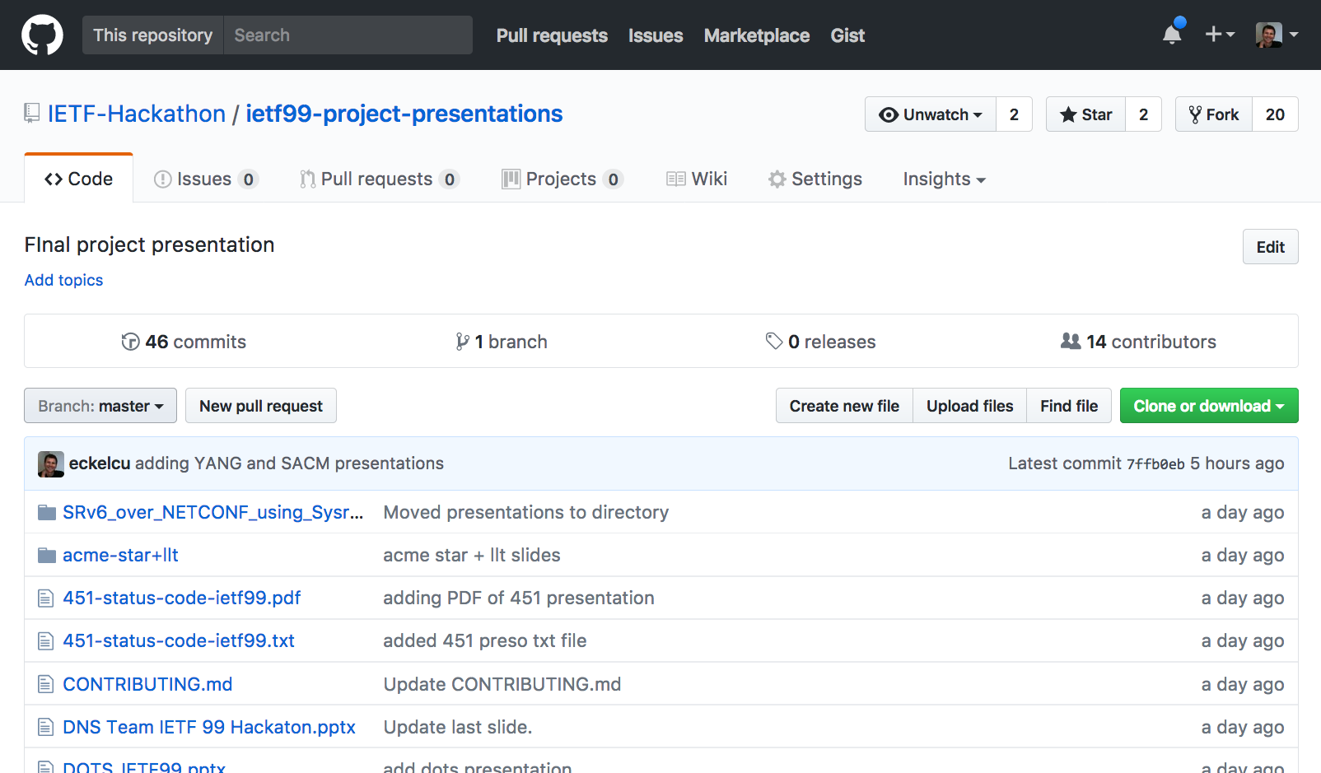
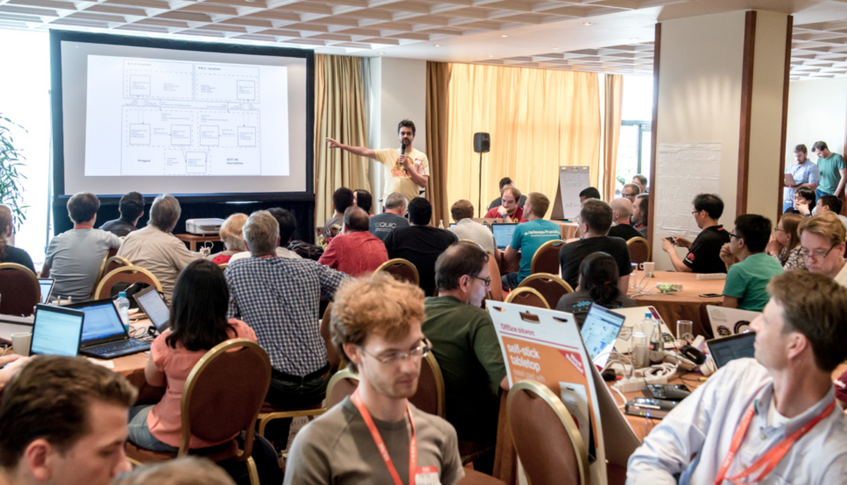
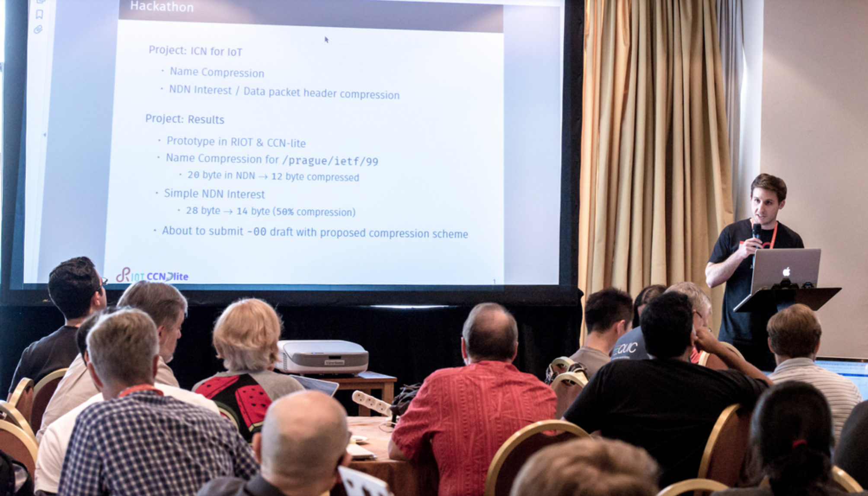
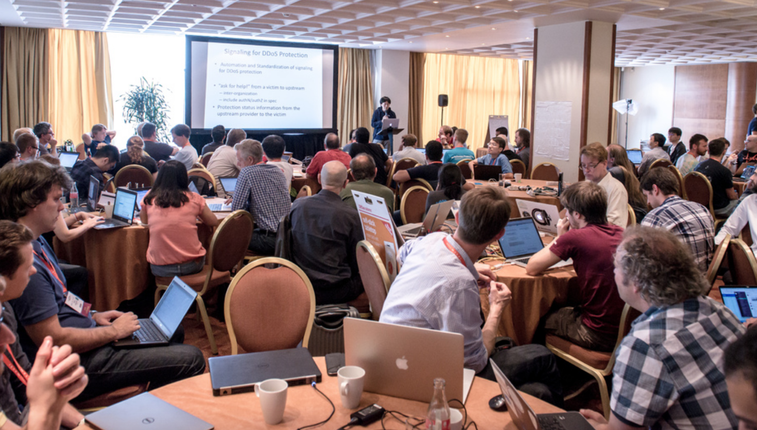
Share Results, Lessons Learned

Slide 5
The Best
New Work - HTTP error code 451
University Work - Interface to Network Security Functions (I2NSF) Framework
“NEAT”est Work - NEAT/TAPS
Interop Work – QUIC
Continuing Work - SCHC implementation and test SCTP
Name - Waiting for go-dots
Overall - SDN Apps for management of microwave radio link via IETF YANG Data Model

Slide 6

IETF 100 Hackathon Singapore, November 11-12
Sponsors
welcome!

